Slide 1

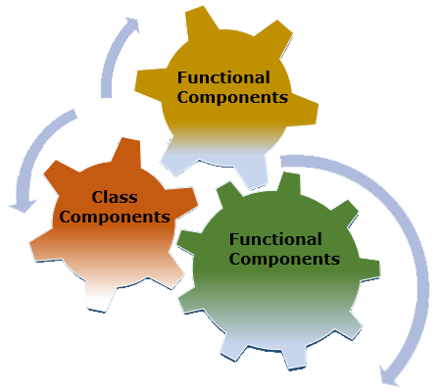

Slide 2
About today…
React.js
Components

Slide 3


Slide 4
Introduction to React Components
Definition
Components are the building blocks of a React application
They are reusable, independent, and encapsulated units of UI
Types
Functional components
Class components

Slide 5
Functional vs Class components
Functional Components | Class Components
Simple functions that return JSX | ES6 classes that extend React.Component
Easier to read and write | They can be more verbose and complex
Suitable for simple UI elements | Used for complex UI logic
They don't have state or lifecycle methods | They contain state management, and lifecycle methods
Recommended for new codebases and are widely used in modern React development | Still relevant, especially in legacy codebases or when working with libraries that haven't fully adopted functional components and Hooks
Align with modern JavaScript practices

Slide 6
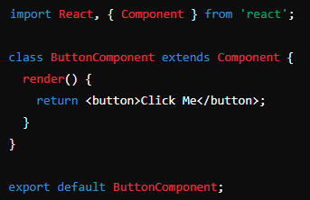
Creating Class Components
Example
Button component

Slide 7
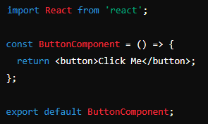
Creating Functional Components
Example
Button component

Slide 8
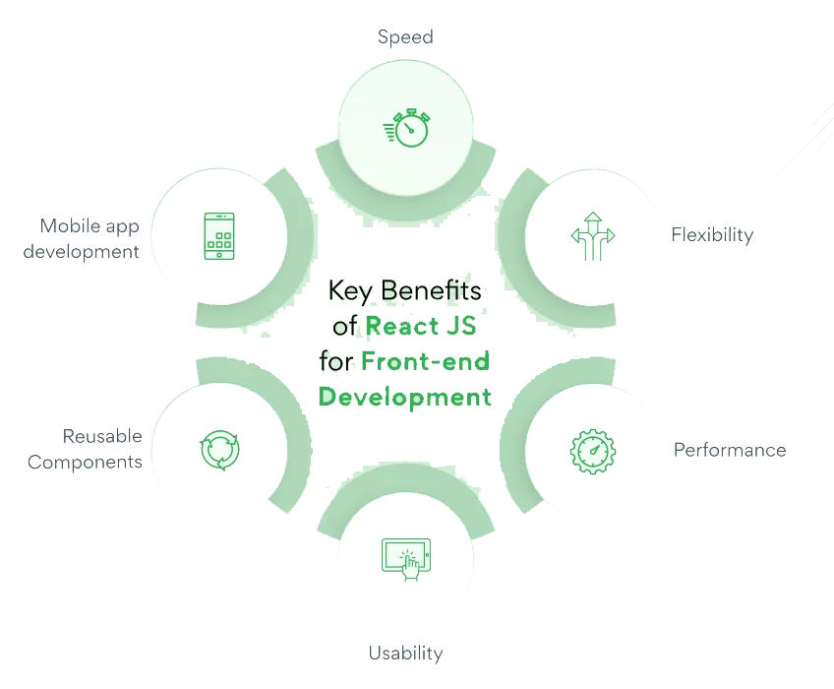
Benefits of Components
Reusability
Components can be reused across the application
Modularity
Encapsulated functionality for easy maintenance
Scalability
Easily scale by adding or modifying components.
Separation of Concerns
Each component focuses on a specific task

Slide 9

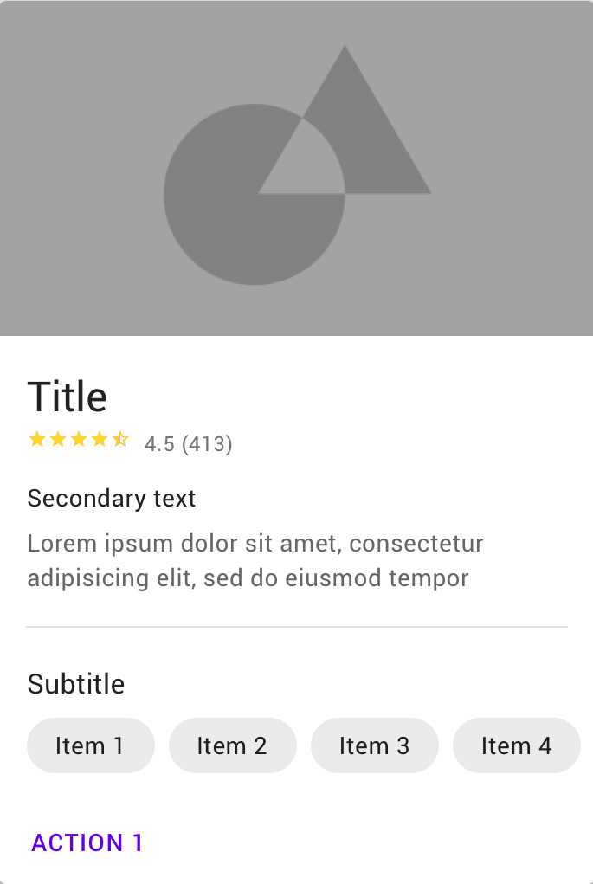
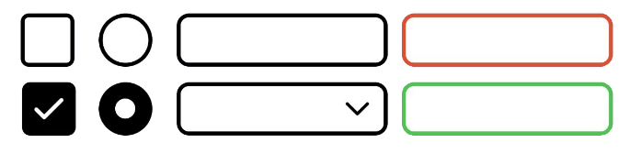
Common Use Cases
ButtonComponent
For buttons and interactive elements
HeaderComponent
For page headers or navigation bars
CardComponent
For displaying content in cards or tiles
FormComponent
For handling form inputs and submissions
ListComponent
For displaying lists of items dynamically

Slide 10

Keep Components Small
Each component should have a single responsibility
Use Descriptive Names
Clearly describe the purpose of each component
DRY (Don't Repeat Yourself) Principle
Reuse components instead of duplicating code
Maintain Component Structure
Follow consistent patterns for readability

Slide 11
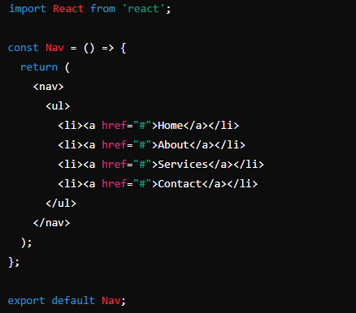
Example
Navbar Component

Slide 12
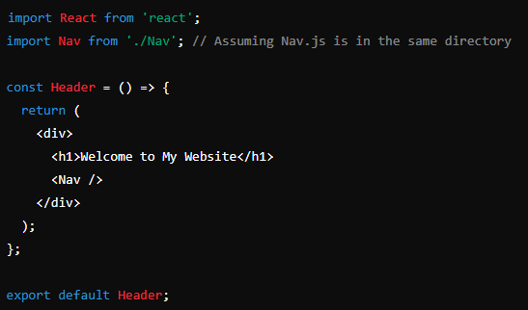
Example
Header Component

Slide 13
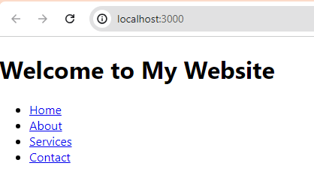
Example
Browser View

Slide 14


Slide 15

What is a component in the context of React development?
What are the two main types of components in React?
What are the benefits of using functional components in React?
How does React handle component re-rendering efficiently?

